Slide 1
Reimer-Tiemann Reaction
Macario ELton Fernandes
FE Computers – Division A
Roll Number : 38

Slide 2
What is the reimer-tiemann reaction ?
Reimer Tiemann reaction is a type of substitution reaction, named after chemists Karl Reimer and Ferdinand Tiemann. The reaction is used for the ortho-formylation of C₆H₅OH (phenols). [In chemistry, a formylation reaction is a class of addition reaction, in which a formyl group is added to a substituent to give an aldehyde.]

Slide 3
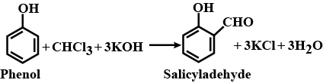
Example of reimer-Tiemann reaction
When phenols i.e. C₆H₅OH is treated with CHCl₃ (chloroform) in the presence of NaOH (sodium hydroxide), an aldehyde group (-CHO) is introduced at the ortho position of the phenolic group and salicylaldehyde (o-hydroxybenzaldehyde) is formed. This reaction is called the Reimer-Tiemann reaction.

Slide 4
More about the reaction :
Since hydroxides are not readily soluble in chloroform, a biphasic solvent system is employed to carry out the reaction. This biphasic solvent system can consist of an aqueous hydroxide solution with an organic phase that contains the chloroform.
These two reagents that are separated are brought together for the reaction to occur. Techniques to bring these two reagents together include – rapid mixing, phase-transfer catalysts or the use of an emulsifying agent.
The reaction needs heat to initiate the process. However, once the reaction is begun, it can prove to be highly exothermic and further increase the reaction rate. This is the reason why the Reimer Tiemann reaction is prone to thermal runaways.

Slide 5
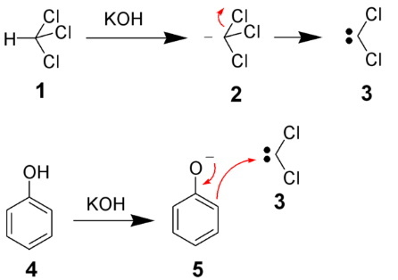
Mechanism of Reimer-Tiemann Reaction
The mechanism of the Reimer Tiemann reaction begins with the deprotonation of chloroform by a strong base to form a chloroform carbanion. This chloroform carbanion quickly undergoes alpha elimination and gives rise to dichlorocarbene – the principle reactive species for this reaction.
Chloroform (1) is deprotonated by strong base (normally hydroxide) to form chloroform carbanion (2) which will quickly alpha eliminate to give dicholorocarbene (3)
This is the principle reactive species. The hydroxide will also deprotonate the phenol (4) to give a negatively charged phenolate (5). The negative charge is delocalised into the aromatic ring, making it more nucleophilic and increases its ortho selectivity

Slide 6
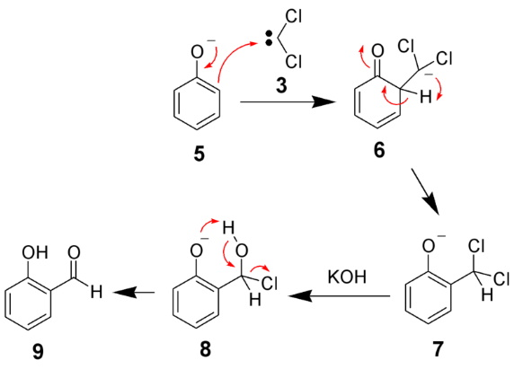
Mechanism of Reimer-tiemann reaction
Nucleophilic attack of the dichlorocarbene from the ortho position gives an intermediate dichloromethyl substituted phenol (7). After basic hydrolysis, the desired product (9) is formed.
Thus, the given phenol is converted into an ortho-hydroxy benzaldehyde using chloroform, a base and acid workup. It can be noted that the carbene is highly electron-deficient due to the electron-withdrawing nature of its two chlorine groups. This is why it is strongly attracted to the phenoxide which is rich in electrons. The interaction favours ortho-formylation of a selective nature.

Slide 7
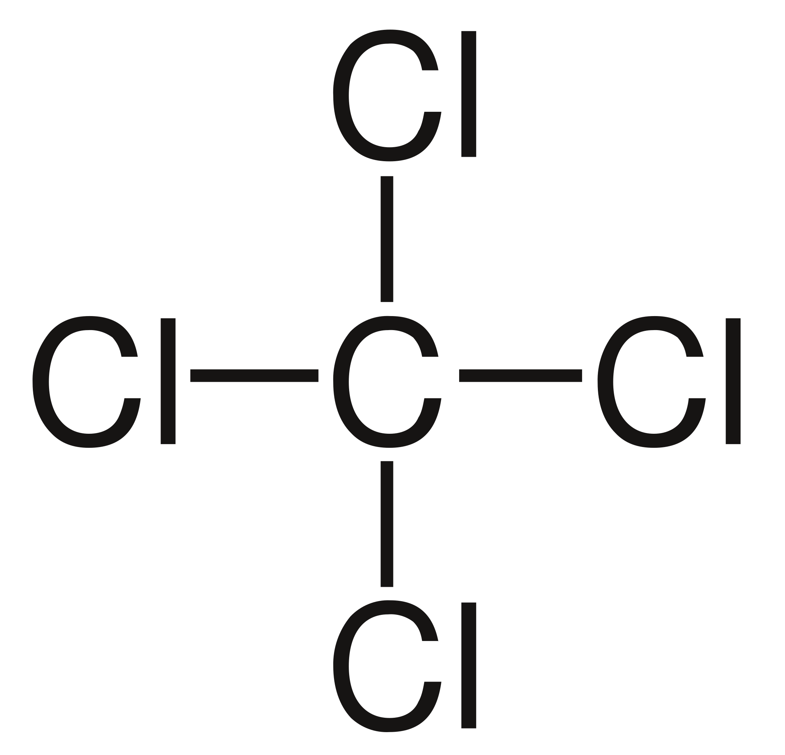
More about the reaction
The direct formylation of aromatic compounds can be accomplished by various methods such as the Gattermann reaction, Gattermann-Koch Reaction, Vilsmeier-Haack Reaction, or Duff Reaction; however, in terms of ease and safety of operations, the Reimer–Tiemann reaction is often the most advantageous route chosen in chemical synthesis. Of the reactions mentioned before, the Reimer–Tiemann reaction is the only route not requiring acidic and/or anhydrous conditions. Additionally the Gattermann-Koch reaction is not applicable to phenol substrates.
The Reimer–Tiemann reaction can be altered to yield phenolic acid by substituting the chloroform with carbon tetrachloride. For instance, the altered reaction with phenol would yield salicylic acid rather than the expected product, salicylaldehyde.

Slide 8
Thank You !
Have a great day !

